Slide 2
Physician Resilience:
A Pilot Program for
Primary Care Pediatrics
Sarah Trane PhD sarah.trane@gmail.com Jennifer Kleven MD jkleven@gundersenhealth.org
Sheryl Gora-Bollom MS LPC ACBS, June 2016

Slide 3
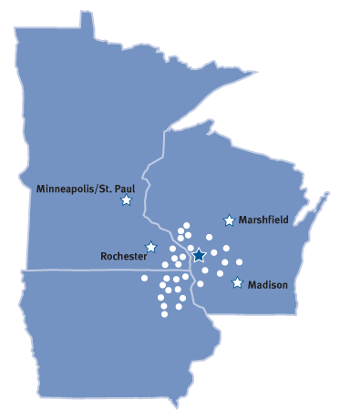
About us…
Integrated Delivery System
Approximately 6,500 Total Employees
795 providers employed / 505 medical staff
59 clinic locations
325-bed Tertiary Medical Center
3 Regional Hospitals
Western Campus of the University of Wisconsin Medical School
Residency and Medical Education Programs
Many affiliate organizations including EMS air and ground ambulance service, rural hospitals, nursing homes, hospice, etc.
Physician-led organization
Notes:
Medical Staff = 498
Associate Staff = 292
Total = 790
Total Employees (excluding Med/Assoc Staff) = 5685
Clinic Locations include Medical, Podiatry, Behavioral Health, Eye, Sports Med.
Number of Medical Clinics 27
Number of Worksite Clinics 3
Number of Behavioral Health Clinics 8

Slide 5
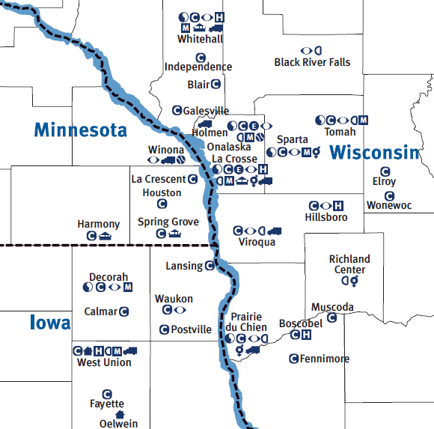
Our Service Area

Slide 6
No conflicts of interest to disclose.

Slide 7
Objectives
Discuss resilience training for physicians
Describe 8-session ACT-based intervention
Present and discuss pre/post measures
Share our experience and learn from others

Slide 8
Physician Resilience Training
“Physician burnout” is an increasing problem with increasing recognition
Many approaches
Literature review
Time frame/group approach
adapted from Colin West, et. al at Mayo Rochester, MN (JAMA, 2014)
Curriculum based on Flaxman, Bond & Livheim (2012)
Notes:
JAMA Intern Med. 2014 Apr;174(4):527-33. doi: 10.1001/jamainternmed.2013.14387. Intervention to promote physician well-being, job satisfaction, and professionalism: a randomized clinical trial. West CP1, et al.

Slide 9
Design
Baseline survey to assess expectations/demographics and validated questionnaires
Sent to all pediatric providers (MDs and NPs) and 1 group of family medicine providers prior to pilot.
8-session intervention (1 session every 2 weeks)
Re-assessment sent following intervention, and at 6+ and 12+ months post-sessions.

Slide 10
Survey
Gender / Age group / Years in practice
I would most like to discuss (n=24):
Clinic workflow (n=13) ←
Taking too much home (11)
Letting go when I make a mistake (9)
Self care (9)
Mindfulness (7)
Debriefing (5)
Boundaries (2)

Slide 11
Measures
Professional Quality of Life Survey (ProQOL)
Maslach Burnout Inventory (MBI)

Slide 12
Professional Quality of Life Scale (ProQOL)
Professional Quality of Life
Compassion Satisfaction
Compassion Fatigue
Burnout
Secondary Trauma
30-item self report
Freely available
Copyright Beth Hudnal Stamm, 2009 www.ProQOL.org

Slide 13
ProQOL
Compassion Satisfaction
“I like my work”, “I am proud of what I can do to help”, I am happy that I chose this work”
Compassion Fatigue
Burnout
“I feel trapped by my job”, “I feel bogged down by the system”, “I feel overwhelmed b/c my caseload seems endless”
Work-related traumatic stress
“I feel depressed b/c of the traumatic experiences of the people I help”, “Because of my work, I have felt on edge about various things.”

Slide 14
Maslach Burnout Inventory (MBI)
Christina Maslach et al., (1996).
Designed to measure burnout
Validated tool
Used in other physician resilience studies
Available for purchase

Slide 15
Categories in MBI
Emotional Exhaustion - feelings of being emotionally overextended and exhausted by one's work
Cynicism/depersonalization - an unfeeling and impersonal response toward recipients of one's service, care treatment, or instruction
Professional Efficacy - feelings of competence and successful achievement in one's work.
http://www.mindgarden.com/117-maslach-burnout-inventory

Slide 16
Structure
8 sessions in a 16 week time frame
Offered at 2 sites - same content repeated
La Crosse/Onalaska
Protected time - (1 hour/session) at 8 am
Invited to attend any or all sessions

Slide 17
Participants
33 MD/DO/APNPs in Department of Pediatrics invited - outpatient clinicians and hospitalists
17.8 (12.1) average years in practice
Range 1-40 yrs
27 completed at least 1 piece of data
18 completed pre and post measures
4 who did not attend any sessions
14 used for data presentation (11 F, 3 M) who attended >= 1 session.

Slide 18
The Sessions
Introduction and setting the stage
Mindfulness
Doing what matters (value-based actions)
Self care (EAP)
Defusion/Debriefing
Self compassion/letting go of mistakes
Boundaries/Limit setting (EAP)
Wrap up

Slide 19
Outline of each session
Begin with BRIEF present-moment awareness exercise (2-5 min max)
Review previous session
New session content
Reflections and learning opportunities for next interval

Slide 20
Psychological flexibility
Mindfulness
Values based action
Cognitive defusion
Acceptance

Slide 21
MINDFULNESS
Present-moment awareness training
Noticing and untangling from your
internal barriers
Strengthening your resilient self
VALUES-BASED ACTION
Defining your values
Mindfully engaging in values-based actions
Using values as a guide to goals and daily behavior
Two-Skills Diagram. From Flaxman, Bond and Livheim (2012), p. 28.

Slide 22
Practice!

Slide 23
Paired t-tests
ProQOL | Mean | Median | t value
Compassion
Pre | 38.29 (6.07) | 37 | -.496, ns
Post | 39.07 (5.78) | 39
Burn Out
Pre | 25.07 (6.44) | 25 | 2.013 (p<.033)
Post | 21.79 (6.179) | 20
Sec Trauma
Pre | 21.57 (5.64) | 22.5 | 1.971 (p<.035)
Post | 19.29 (6.92) | 17.5

Slide 24
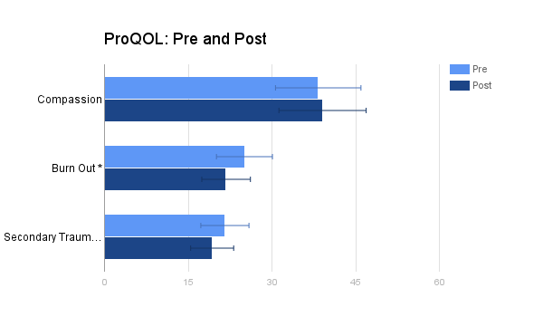
Low (<23)
High (41+)
Average (23-41)
Notes:
Comp: t=-.496, NS.
BO: t=2.013, p<.033, Cohen’s d=.521(med).
SecTr: t=1.971, p<.035. Cohen’s d=.362 (small-med).

Slide 25
Paired t-tests
MBI | Mean | Median | t value
Exhaustion
Pre | 16.64 (7.52) | 15.5 | 1.37, (p<.098)
Post | 14.43 (6.31) | 13.5
Cynicism/Depers
Pre | 10.86 (7.71) | 10.5 | 1.04 (ns)
Post | 9.07 (5.25) | 8
Prof Efficacy
Pre | 30.00 (5.16) | 31 | -.33 (ns)
Post | 30.50 (5.61) | 30.5

Slide 26
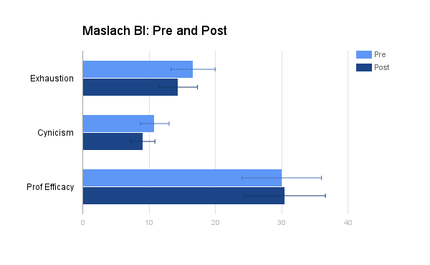
Ex: Low 0-10 < 11-15 < 16+ High
Cy: Low 0-5 < 6-10 < 11+ High
PE: Low 0-23 < 24-29 < 30+ High
Notes:
EX: t=1.366, p<.098, ns but maybe trend. CY: t=1.042, ns. PE: t=-.330, ns.

Slide 27
Post Survey
Why didn’t people attend:
Schedule conflict
No responses to “not interested”
Which session most useful:
Values/value-based actions !!!
Self compassion/letting go of mistakes
Mindfulness
Boundaries/limit setting
Defusion

Slide 28
Post Survey
“I am using skills discussed…”:
maybe every other week
3-4 times/week
“The skills I use the most are…”:
mindfulness
doing what matters (values)
self compassion/acceptance

Slide 29
Comments
“Thank you so much for doing this. There is no question that the primary difficulty with work is too much to do in the time allotted. Obviously, this program did not address that.
However, it did address everything that leads to burnout, and I found it extremely valuable.”

Slide 30
Our lessons learned
High acceptance of program among those who participated -- asked for MORE
Need administrative support to get time needed for intervention
Providers found value in values
Pieces of bigger puzzle need to be addressed (e.g., workflow)
Attention of Executive Committee
Consideration of ACT vs. Ballint groups moving forward

Slide 31
Questions and Discussion

Slide 32
Notes:
FYI: extra slides used in sessions in case we have time to share.

